Slide 1
Bite sized training sessions:
Process Modelling – Part 1 of 2
Process Model Diagrams
Notes:
NOTES

Slide 2
Objectives
To understand
  Why do process modelling
  What is a process model
To be able to
  Read a process model
  Build a process model
  Critically review a process model

Slide 3
Why do process models?
Because process should be the focus of design and development:
  Functional requirements define what capabilities of the solution are required in order to achieve objectives.
  Each functional requirement results in at least 1 process
  Processes specify business rules – aka requirements
  Process that don’t manipulate data don’t do anything

Slide 4
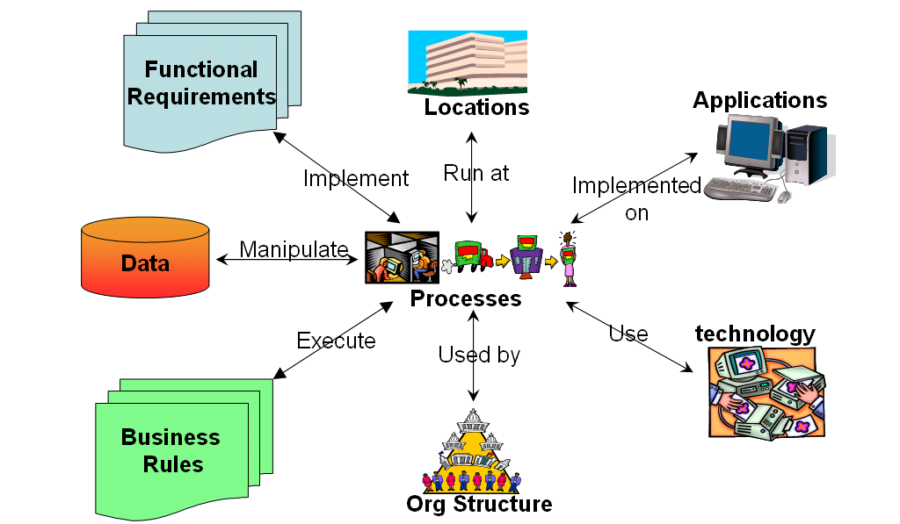
process models are the pivot around which solutions are specified, designed and implemented
Notes:
Introduction
The diagram illustrates how process specifications are the pivot around which solutions are specified, designed and implemented.
Processes are the user interface to a solution – as such they are highly visible and a lot of project effort is focussed on process modelling. In fact, there is a perception in some quarters that Business Analysts just draw process models and this is all they do. However, process models (the drawings of processes) are only one facet of the specification of a process. These are the other facets and this modules will look at the reasons why process modelling should be done (the benefits) and the techniques for
drawing process models
managing process decomposition
documenting process execution logic
documenting process non-functional requirements
mapping processes to functional requirements
mapping processes to data used (but not how to model data requirements – a module in it’s own right!)

Slide 5
What are process models
Models of business process requirements for a solution – computerised or not.
Definitions of the process requirements for the solution.
Are – by definition – the process scope of the solution.
It should be possible to trace back every component of a process model to the objectives it helps achieve
Process models consists of 4 components…

Slide 6
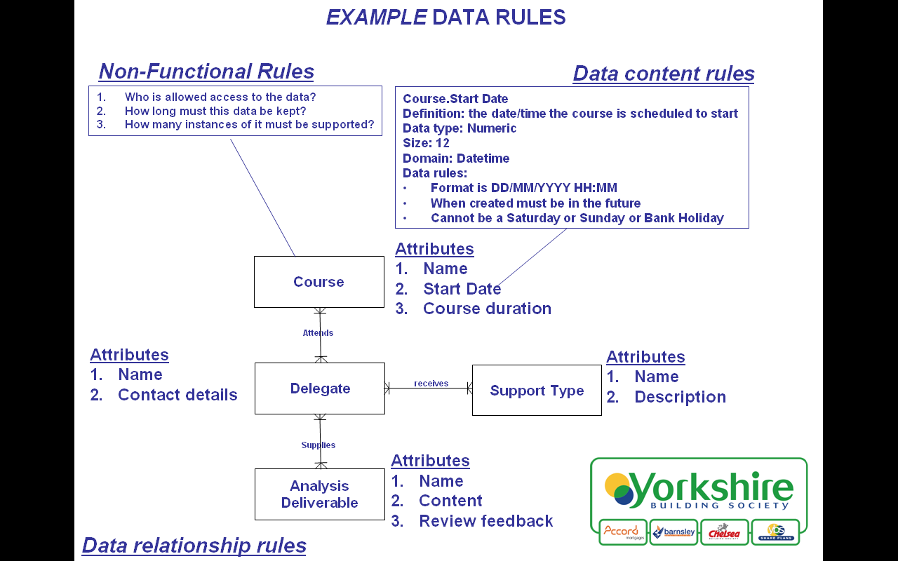
Data Usage Rules
Slide: <number>

Slide 7

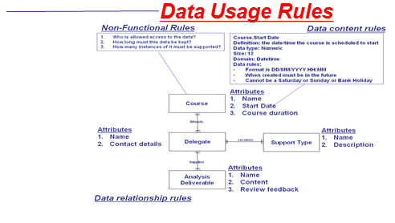
Process models consists of 4 components…
Process execution rules
A BA can request one of 4 types of support:
Phone or email based query about a specific point
Informal review of a project deliverable
Formal review of full set of project deliverables
Facilitated workshop of how to apply analysis to a specific project
1. In the case of phone or email query about a specific point
the BA poses the question and the training provider will provide guidance for how the technicalities of Business Analysis apply to the problem
Informal reviews of project deliverables will be done by email and will only discuss the technicalities of Business Analysis in relation to the document
Formal reviews will involve the BA sending the full set of Analysis deliverables to the training provider who will critique them from a technical perspective and then deliver the feedback in a one-to-one structured feedback session on the client site
Facilitated workshops will be initiated by the BA - the training provider will supply workshop agenda and prerequisites which the BA will use to organise the workshop. The training provider will then facilitate the workshop for the project.
Non-functional Rules
Who is interacts with process
Where they are
Availability of process
Volumetrics
Performance of process
Security & Authorisation levels
Process dependency rules
BA requests
support
Conduct
Training
Provide
BA support
Analysis Phase
Of Project
concludes
Monitor
Analysis
quality

Slide 8
Process Dependency Rules
- in our case using BPMN
N.B.:
process execution logic
process non-functional requirements
process data usage
are the subject of the next bite sized training module

Slide 9
What is BPMN
Business Process Modelling Notation
An ‘industry standard’ process modelling technique
Developed by Business Process Management Initiative (www.BPMN.org)
Release 1 - May 2004
Goal – to provide a notation understandable by business users, business analysts and technical developers
Is event based process modelling
Contains some powerful constructs
Visio stencil free download at www.omg.org/bpmn/documents/Documents/BPMN_0-9-V2003.vss
We will cover only a sub-set of the most useful notation
Ref: article on the BA Training sharepoint site

Slide 10
BPMN basics
Events
Start
Intermediate
End
BA requests
support
Conduct
Training
Provide
BA support
Analysis Phase
Of Project
concludes
Monitor
Analysis
quality
Connecting objects
Conditional
Unconditional
message
Process
Activity
Sub Process
Task

Slide 11
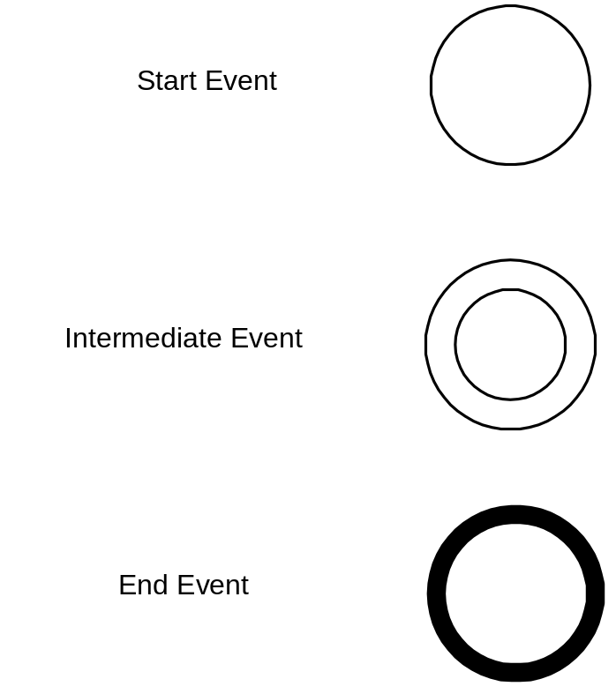
(real world) Events
A process may have any number of any category of events.
Something happens which triggers the start of a process.
During a process, the next step must wait for something to happen.
A point at which the process may stop.
Notes:
10/09/09

Slide 12

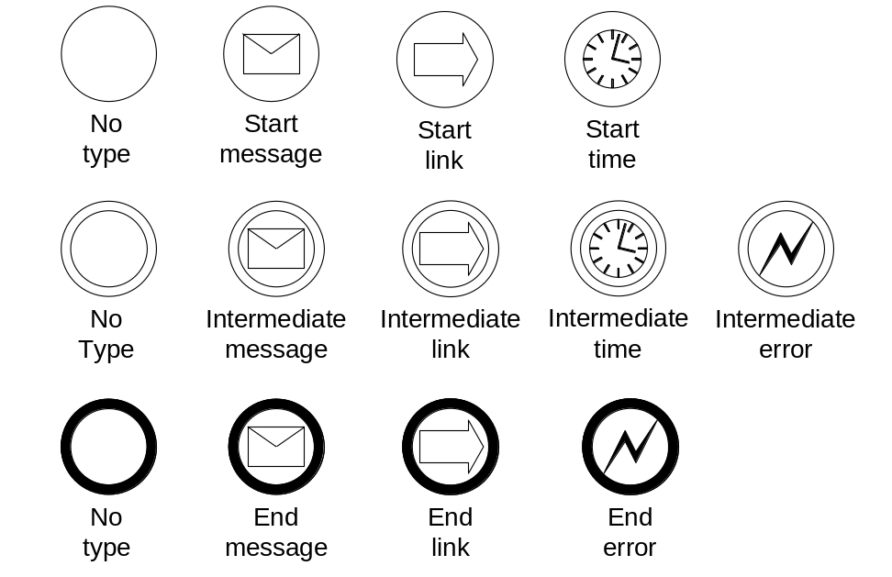
The Most Useful Event Types
Valid combinations of Event Category & Type

Slide 13
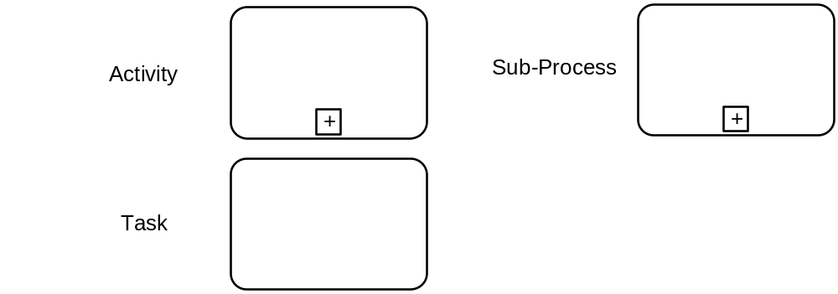
BPMN Processes
Note:
Differentiating between “activity”, “sub-process”, “task” is of arguable value – using a generic “process” to cover all 3 seems to work fine.
Notes:
10/09/09

Slide 14
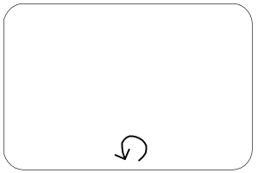
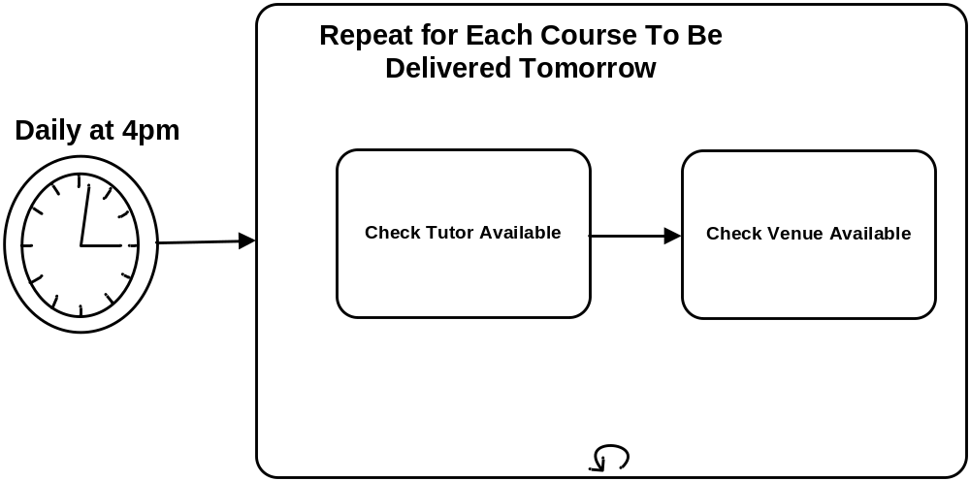
Iteration
Serial loop – process is performed zero, one or many times
(one after the other)
Notes:
10/09/09

Slide 15
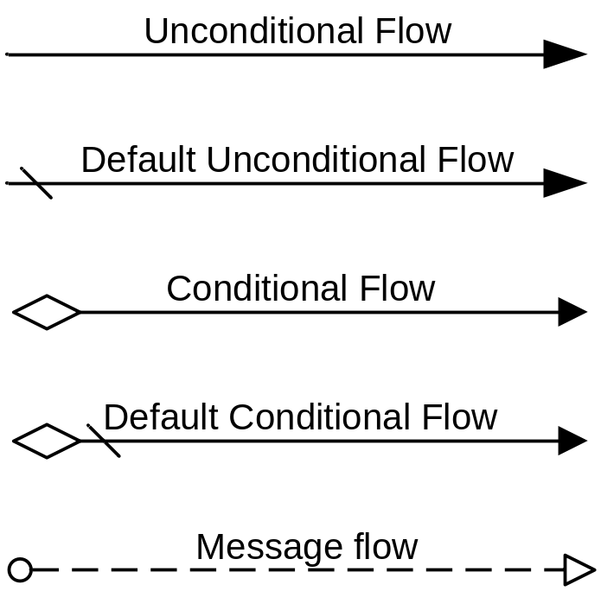
Process flow connectors
Can only be used within a single Pool
Can only be used between Pools
Notes:
10/09/09

Slide 16
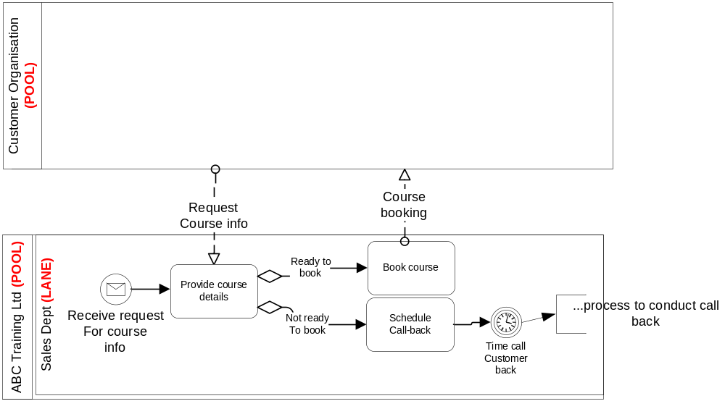
Pools, Lanes & Message Flows
A message cannot flow between two objects in the same Pool
Notes:
10/09/09
A Message Flow is a dashed line that is used to show the flow of messages between two entities that are prepared to send and receive them. In BPMN, two separate Pools in the Diagram will represent the two entities.

Slide 17
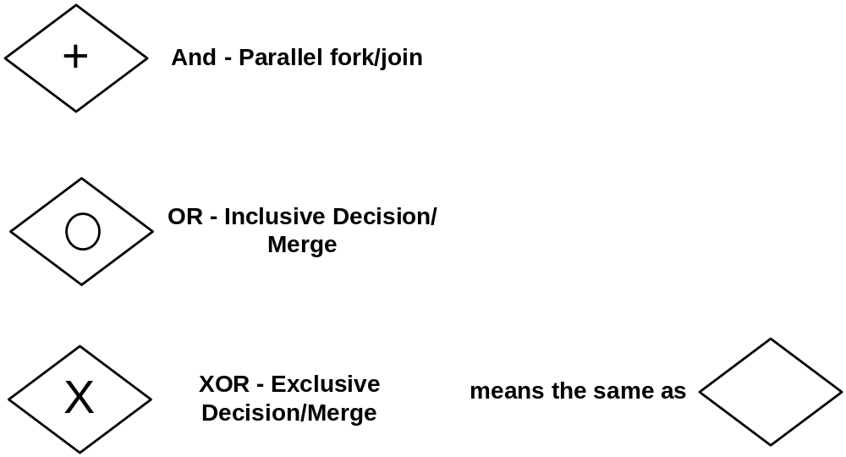
Gateways Types
Gateways control convergence OR divergence of process flows - so not equivalent to decision diamonds.
These decisions are based on the evaluation of a piece of data within the preceding process.
Notes:
10/09/09

Slide 18
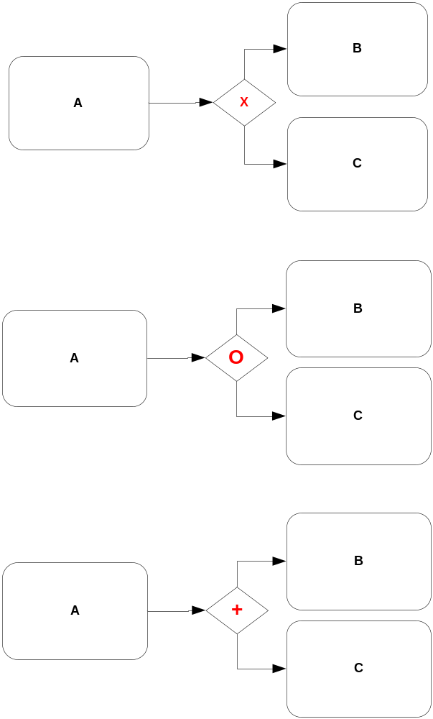
Divergence
Exclusive Or: When A has finished
perform B or C
Inclusive Or: When A has finished
perform B or C or both
And: When A has finished
perform B and C
Notes:
10/09/09

Slide 19
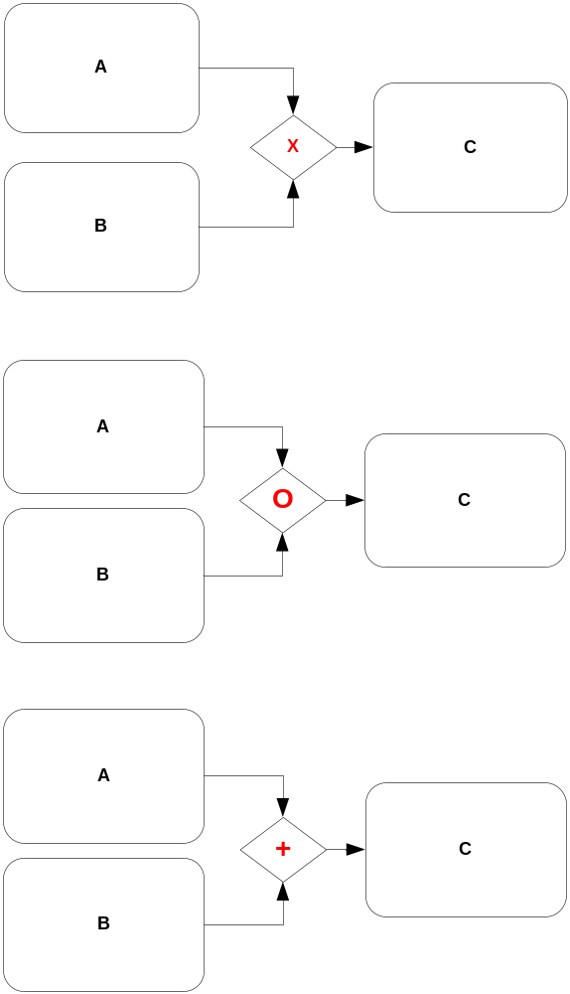
Convergence
Exclusive Or: Perform C
when A or B have finished
Inclusive Or: Perform C
when A or B or Both have finished
And: Perform C
when A and B have finished
Notes:
10/09/09

Slide 20
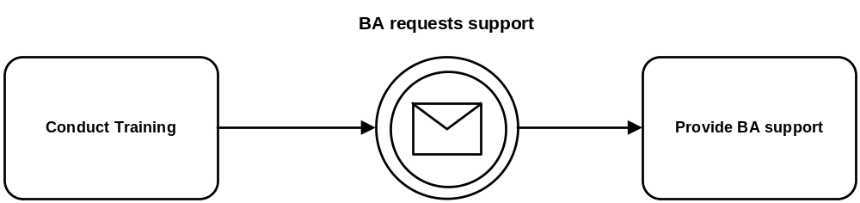
Process Break
An intermediate message can be used to show a process break.
Having conducted training, the process waits until a BA requests support.
Assumption: The next step is always BA requests support…?
Notes:
10/09/09

Slide 21
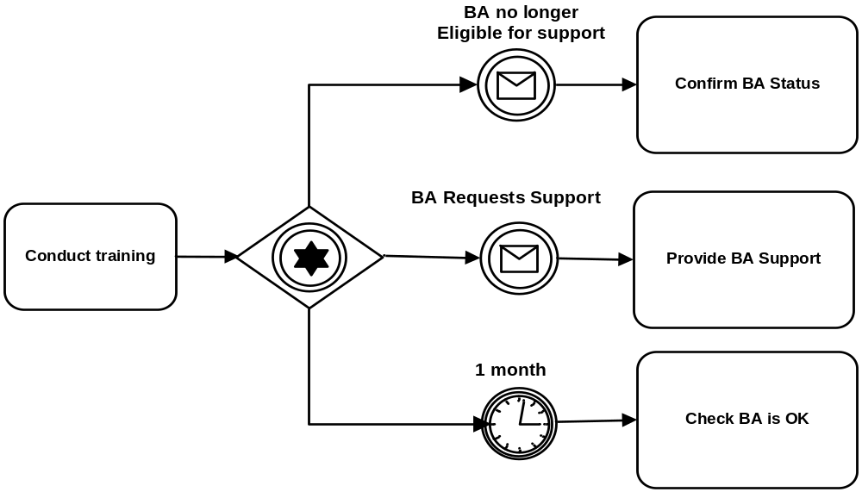
Event Based Gateway
An “exclusive or” decision made on the basis of whichever associated intermediate event occurs first.
There is no symbol for inclusive OR presumably because it cannot happen?
Notes:
10/09/09

Slide 22
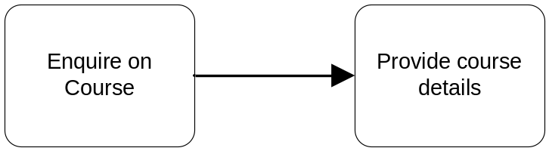
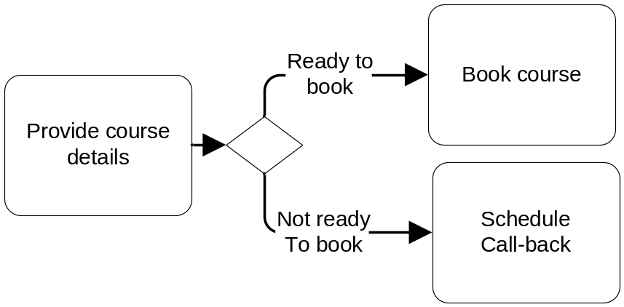
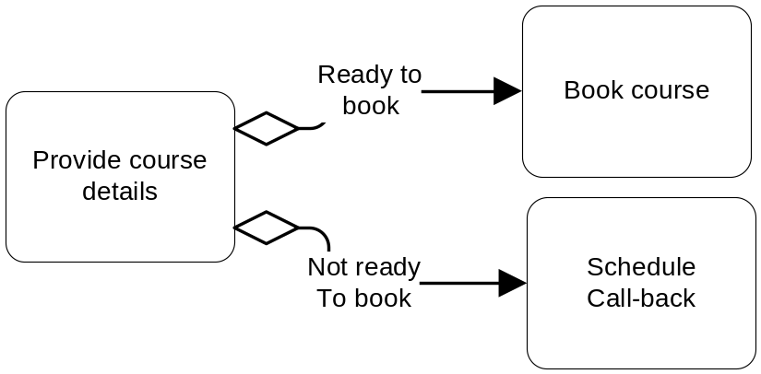
Sequence Flow of Control
Unconditional flows
Business rules enforced:
when a course enquiry is made, course details are ALWAYS provided.
The only time that course details will be provided is when an enquiry is made.
Do these rules reflect business requirements?
Are they workable?
Conditional flows
Are these two process flows equivalent?
Which is better?
Notes:
10/09/09

Slide 23
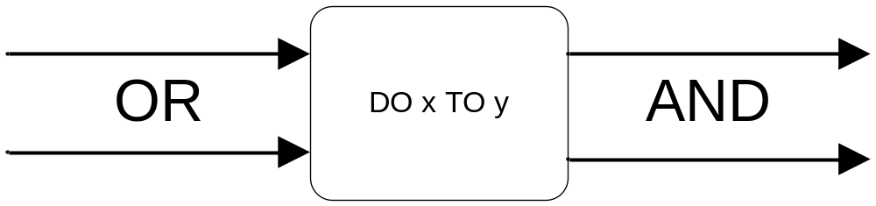
BPMN defaults for Process Flows
BA requests
support
Conduct
Training
Provide
BA support
And
Analysis Phase
Of Project
concludes
Or
Monitor
Analysis
quality

Slide 24
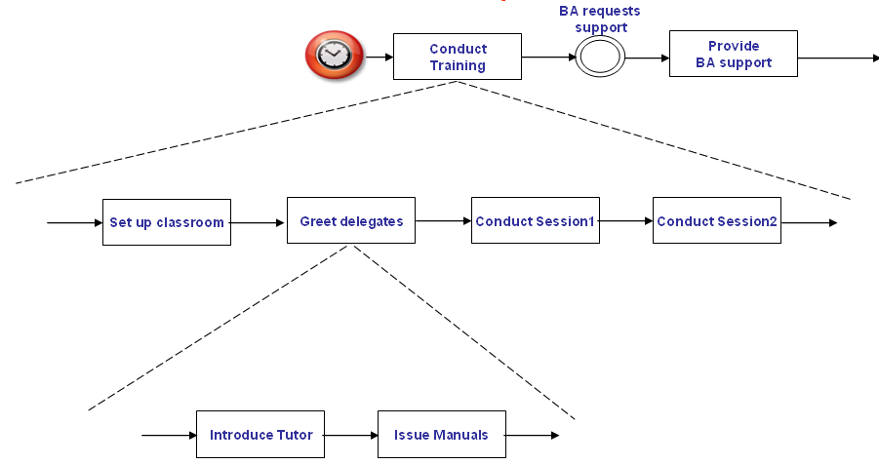
Process Decomposition
Activities
Top level
+
+
Sub-Process
Intermediate levels
+
+
+
+
Task
Bottom or atomic level
Notes
A process model does not have to be decomposed.
Each level of these processes/tasks must ‘balance’ with the level it is a decomposition of: if a process has one input and that process is decomposed, then the input must also be input to at least one sub-process/task on the decomposition and there can be no other inputs although the single input can trigger more than one sub-process/task.

Slide 25
Identifying Processes
(known in BPMN as Activities, Sub Processes and Tasks)
Processes should be named
  verb phrase + noun phrase =
  DO something TO something (the “do to” rule)
Top level processes (activities):
    Guideline of mutual dependency.
    Guideline of initiation and outcome linkage.
    Guideline of user concurrency.
    Guideline of meaningfulness.
Any level processes (sub-processes) and tasks
    Guideline of unit of work.
    Guideline of conciseness of specification.
    Guideline of transaction steps.
Notes:
Top level processes: Arguably the easiest level to identify as there a good set of guidelines for identifying a process:
Guideline of mutual dependency: if you conclude that Process A is always performed when Process B is performed, and that the only time Process A is performed is when Process B is performed then these processes should be combined in to one process. Example: Whenever the Process Create Customer is performed, the process Check Credit Rating is performed and the only time that Check Credit Rating is performed is when Create Customer is performed. Therefore, combine these processes.
Guideline of initiation and outcome linkage: if you conclude that whenever Process A is invoked under certain circumstances it will always result in initiating Process B (and/or outputs) and when Process A is invoked under different circumstances it always invokes Process C (and/or outputs) then it is likely that Process A has 2 or more processes combined in it and should be split out. Example: When Create Customer is invoked for a normal customer then the business rule is that the next process is always Place Order. When Create Customer is invoked for a customer who is also a company employee, then the business rule is that next process is always Authorise Employee Customer. In this case it is likely that Create Customer has another process in it (Create Employee Customer) that in turn would include Authorise Employee Customer under the rule of mutual dependency.
Guideline of user concurrency: If a process needs 2 or more different Job Roles in order to execute then it is highly likely there are 2 or more different processes in it unless there is a business rule that says this process must be executed by these job roles at the same time. Example: Suppose a company allows its employees to be customers of that company’s services, but to prevent fraud more stringent checks are made for so-called Employee Customers. If the process Authorise Employee Customer needs authorisation by Employee Line Manager role and Sales & Marketing Director role then consider having 2 processes because without doing this once the Employee Line Manager role has authorised the Employee Customer the process will wait until the Sales & Marketing Manager has also authorised it!
Guideline of meaningfulness: If Process A does not produce any meaningful (to the Business) outcome or output then consider merging with the preceding or following process.. Which process to merge with should be assessed using the other guidelines. Example: the process Record Customer Date Of Birth does not produce a meaningful outcome and can be combined under the guideline of mutual dependency with Create Customer
Any level processes and tasks
Guideline of unit of work: if it is conceivable that the process could or should be halted so that other processes can be started, then split the process. Example: The process Create Customer might contain the logic to record marketing preferences. This information is not required to Place Order so consider splitting Create Customer in to 2 processes: Create Customer and Record Marketing Preferences (which could be done at a more convenient point).
Guideline of conciseness of specification: if it is not possible to specify the execution logic on one page then consider splitting the process. This guideline is weaker than most.
Guideline of transaction steps: if a process performs only a few or one action then consider merging with other processes using the other guidelines. Example: Record Customer First Name and Record Customer Surname are probably part of the same process!

Slide 26
Process for Modelling Processes
Identify starting events – always verify in scope
  Operational events that trigger processes
  Data maintenance events (almost always reference data)
  Reporting events to monitor business performance
For each starting event
  Assign the event to an originating Pool (and lane if possible)
  Define the “happy path” top level process response
    For each process step
      Assign the lane
      Define other normal exit paths
      Define other exceptional exit paths
For each top level process
  Decompose if and as required
  Balance
N.B. documenting processes is in the next bite sized training module

Slide 27
Minor Exercise
I own and manage a florist’s shop called My Florist.
I want to start emailing reminders to customers when special occasions are due for which they have brought flowers in the past – for example a spouse’s birthday.
So when a customer buys flowers, I want the florist to capture the occasion and email address (if possible: there may be no special occasion involved, or they may not wish to tell us what it is, or they may not want to tell us their email address).
Then daily at 9am I want to be able to review what reminders could be sent that day, choose which ones I want to send, write an email and send it.
I may want to add types of special occasions.
Draw up a process model to support that process.
Time: 15 minutes.

Slide 28
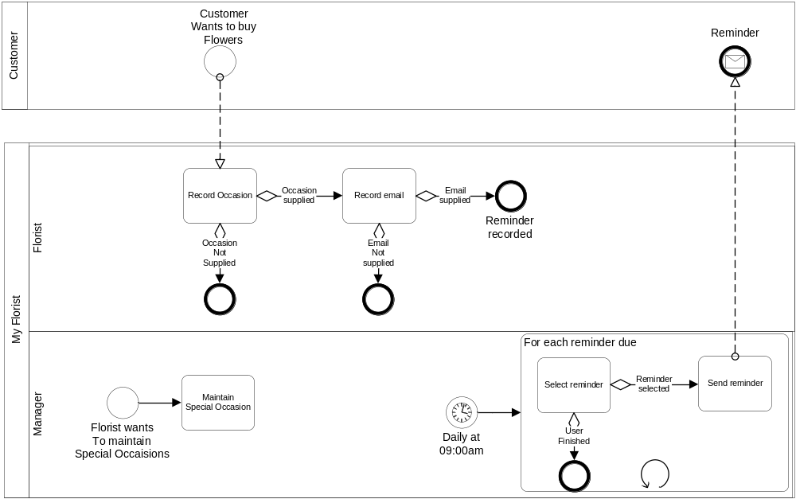
An answer
N.B. The same person could fulfil the role of Florist AND Manager.

Slide 29
Major Exercise
You are business analysts working for a company called re-Evolution Coffee Houses Ltd
You have been given a piece of work – ref handouts
You have already produced a first cut data model
Produce a top level process model showing
  Pools
  Lanes
  Events
  Processes and dependencies between processes
Suggestion: follow the process for producing a process model diagram 3 slides previously
The business users will be available for questions

Slide 30
Major Exercise
If you need to make an assumption about business requirements or anything else then document it
Time allowed: 1 hour
Deliverable:
  Flip chart process model
  Flip chart assumptions
The other team will present your process model – so document everything that needs to be presented clearly
Don’t worry about completing the exercise
Do worry about the quality of what you get through

